Slide 1

Energy consumption details for the past 33 years in the U.S.A.
PRALAY SANKAR MAITRA (A23029)
SAYAK KUMAR DUTTA (A23036)
SHREYAN BHATTACHARJEE (A23038)

Slide 2
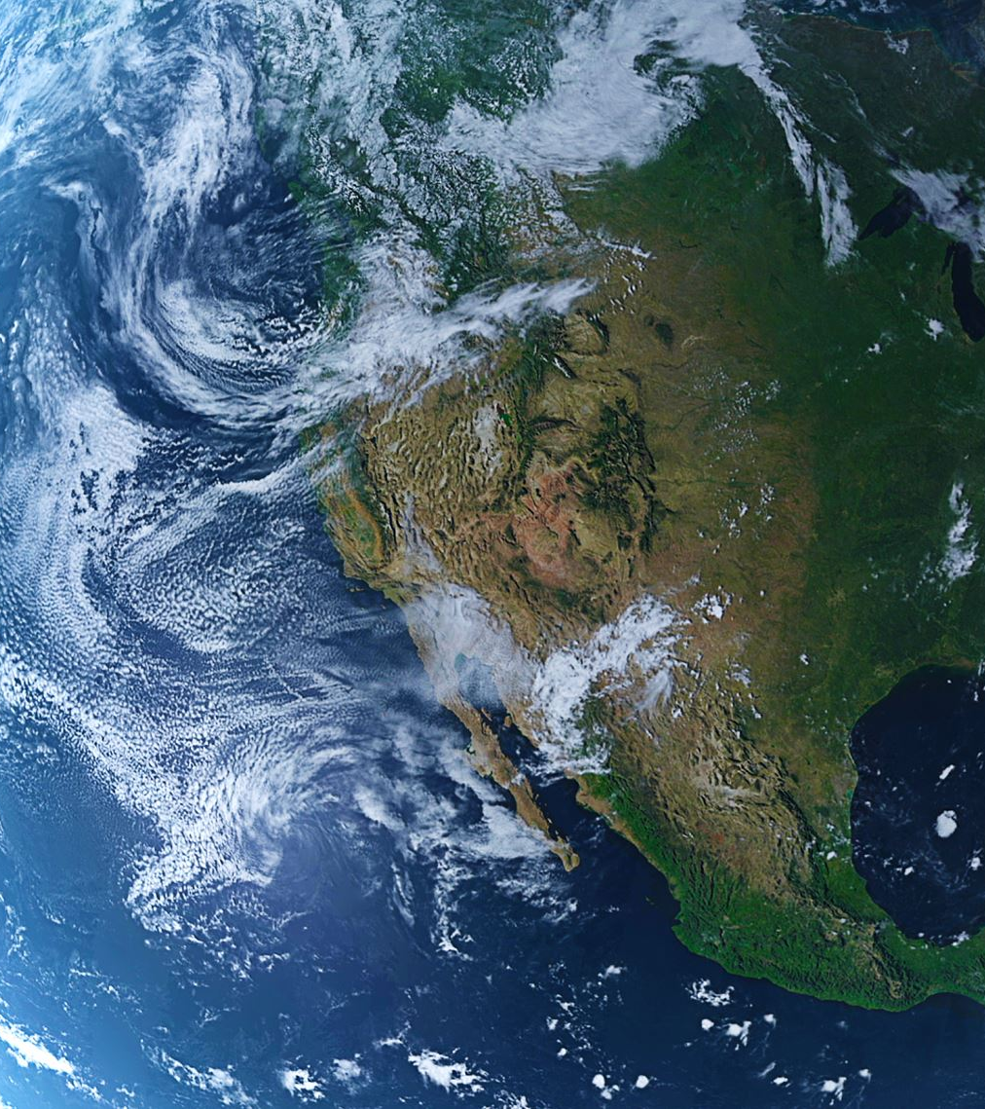
Research Objective
To analyze the distribution of energy consumption from 1990-2023 over individual states of the United States of America.
To identify which region vis-à-vis which state within the regions, like South Midwest West and Northeast, is consuming the highest energy within the given time period.
To analyze trends and seasonality within the line charts for the given categories.

Slide 3

Data Collection
Data has been collected from the U.S. Energy Information Administration
Link is given as follows:
https://www.eia.gov/electricity/data/state/

Slide 4

Methodology
Computation of total energy consumption has been made using the DAX signature, (SALES)/UNIT PRICE .
Regions have been made as given on the Wikipedia page using DAX: https://en.wikipedia.org/wiki/List_of_regions_of_the_United_States
Regions were as follows: South, Midwest, West, Northeast.
Charts like line, pie, bar, and tree map were used to see the exact definition of power supply usage in the States.
Energy bracket was made using given values from “Very Low”, “Low”, “Medium”, “High”, and “Very High”.

Slide 5
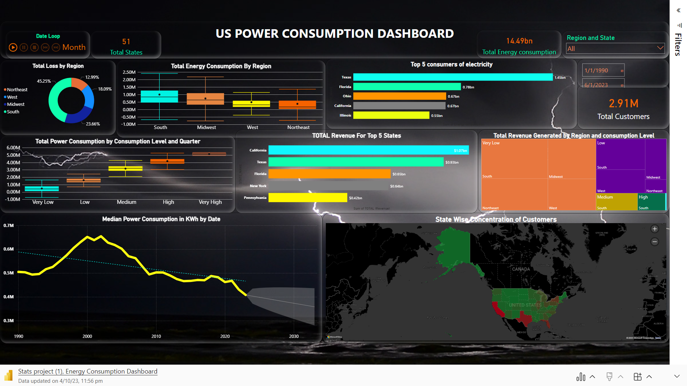

Slide 6
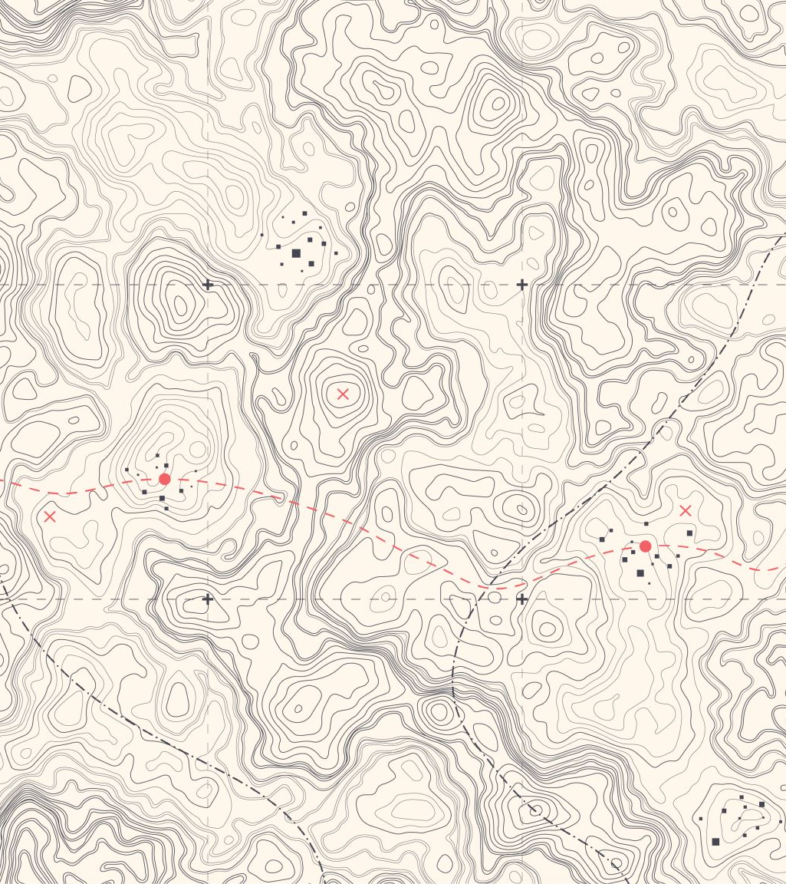
Interpretation
Texas shows the highest power consumption
California produces the highest revenue in terms of energy.
Southern states have shown the highest power consumption bracket which includes the state of Texas.
California, followed by Texas has the highest consumer base.
There is high power loss in the southern states especially Texas as compared to states like California as revenue generated from California is highest but power consumption in Texas is the highest.

Slide 7
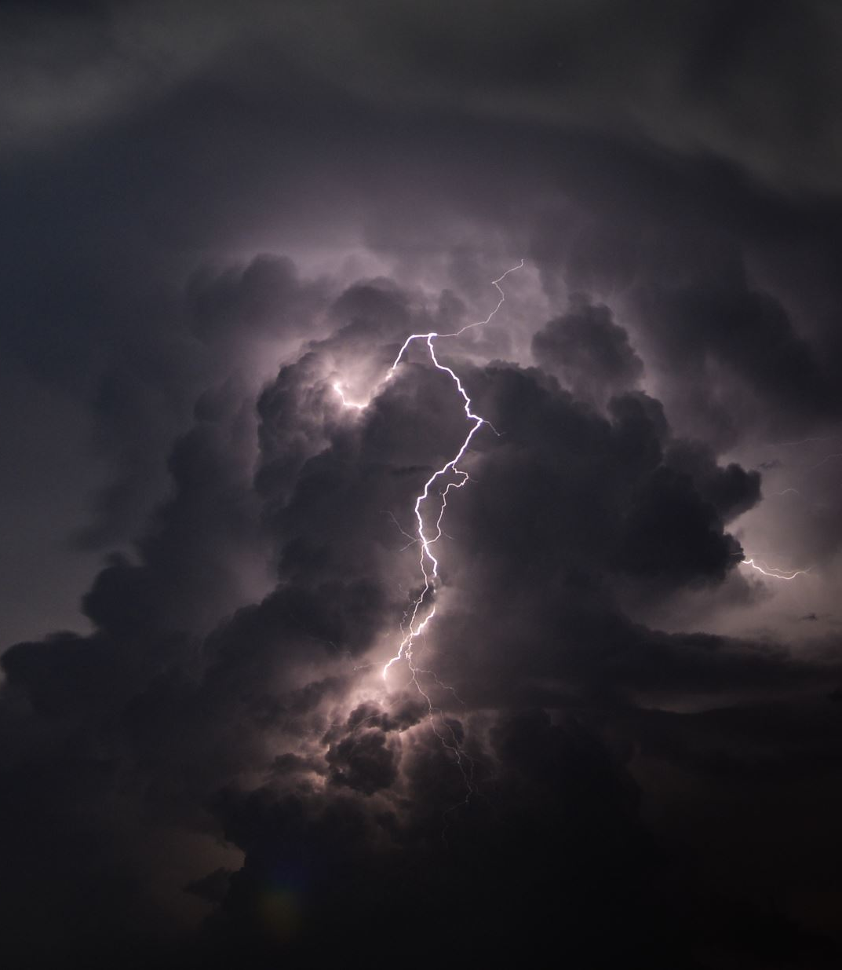
Conclusion
There is a surge in the median power consumption between the years 1995-2000 after which there is a gradual fall.
Loss of power in the southern states is maximum.
Storms and hurricanes in the southern states could be a reason of the wide gap between the revenue and the sales.
The Northeastern states consume the least power due to colder climatic conditions.

Slide 8

THANK YOU – Q & A

